Slide 1
COMPUTER FUNDAMENTAL
INPUT DEVICES

Slide 2
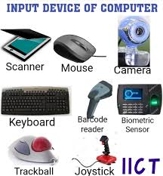
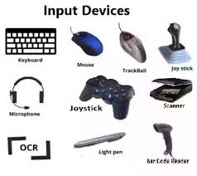
What are Input Devices?
An input device is any hardware device that sends data to a computer, allowing you to interact with and control it. The picture shows a Logitech trackball mouse, which is an example of an input device.
The most commonly used or primary input devices on a computer are the keyboard and mouse. However, there are other devices that input data into a computer.

Slide 3
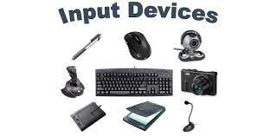
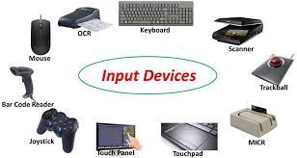
Input Devices

Slide 4
Types Of Input Devices
Keyboard
Keyboard is the most common and very popular input device which helps to input data to the computer. The layout of the keyboard is like that of traditional typewriter, although there are some additional keys provided for performing additional functions.
Keyboards are of two sizes 84 keys or 101/102 keys, but now keyboards with 104 keys or 108 keys are also available for Windows and Internet.
Mouse
Mouse is the most popular pointing device. It is a very famous cursor-control device having a small palm size box with a round ball at its base, which senses the movement of the mouse and sends corresponding signals to the CPU when the mouse buttons are pressed.
Generally, it has two buttons called the left and the right button and a wheel is present between the buttons. A mouse can be used to control the position of the cursor on the screen, but it cannot be used to enter text into the computer.

Slide 5
Types Of Input Devices
Scanner
Scanner is an input device, which works more like a photocopy machine. It is used when some information is available on paper and it is to be transferred to the hard disk of the computer for further manipulation.
Scanner captures images from the source which are then converted into a digital form that can be stored on the disk. These images can be edited before they are printed.
Joystick
Joystick is also a pointing device, which is used to move the cursor position on a monitor screen. It is a stick having a spherical ball at its both lower and upper ends. The lower spherical ball moves in a socket. The joystick can be moved in all four directions.
The function of the joystick is similar to that of a mouse. It is mainly used in Computer Aided Designing (CAD) and playing computer games.

Slide 6


